Slide 1

Data-Limited Fisheries Toolkit
Evaluating management strategies for data-limited fish species
IOTC Case study 1, longtail tuna
May 2017

Slide 3
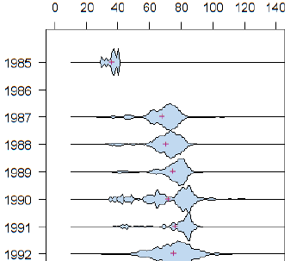
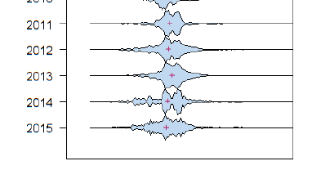
LFC (5% sel)
LFS (95% sel)
Age 1
Maximum length (Linf)
Length at 50% maturity

Slide 4
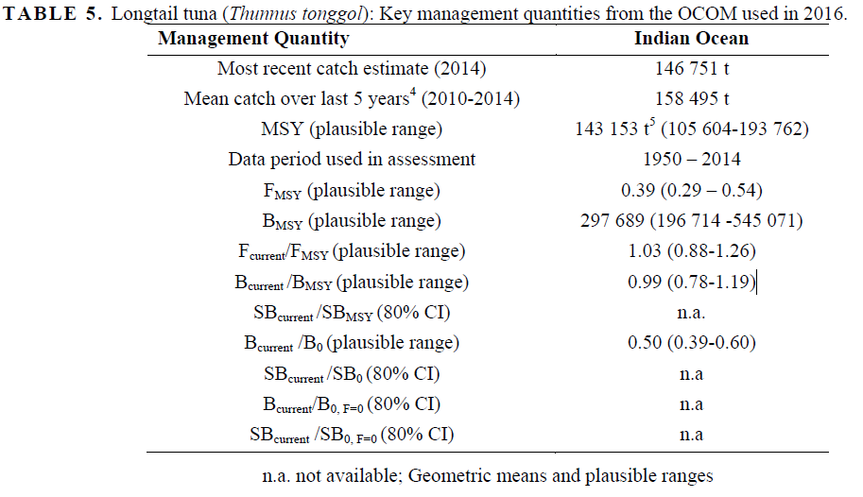
Supporting documentation (comment on reliability of estimates)

Slide 5
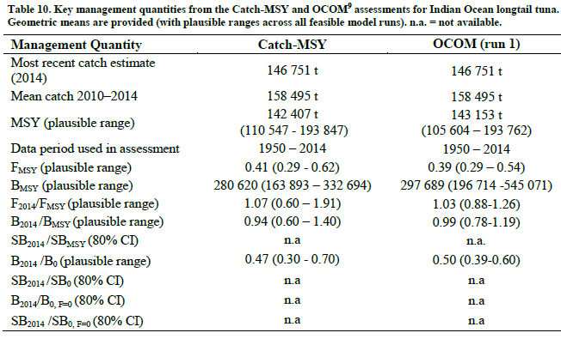
Catch-MSY (a critique)

Slide 6
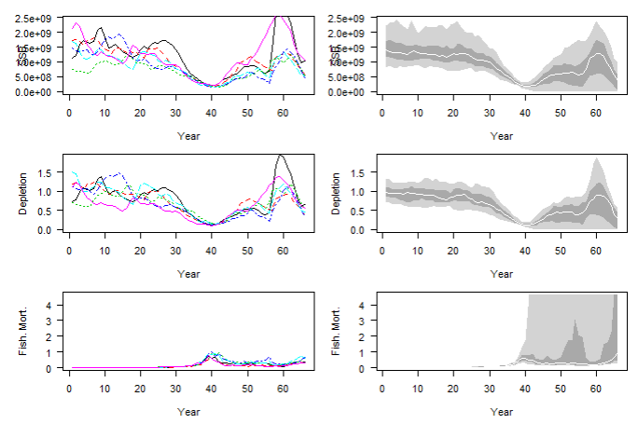
Stochastic SRA results

Slide 7
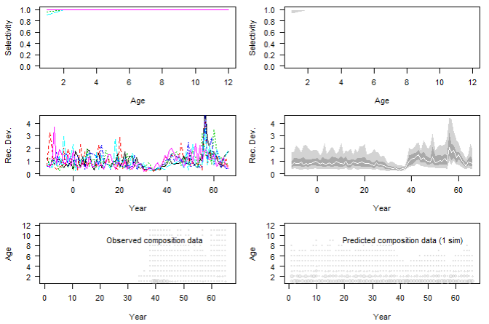
Stochastic SRA results

